Slide 1
Topics of this course
What is CS ?
Lect 1: what is computer
Lect 2: how is computer system working
Lect 3: Turing machine & P vs NP
Lect 4: computational thinking & algorithm
Lect 5: cloud computing
Why is CS so hot ?
How to learn CS ?

Slide 2
Cloud computing
qiang@suda.edu.cn

Slide 3
What is （CS） network？
A general network: C with connection to A and B
Computer networking:
Provides a virtual computer C by connecting computers (A,B,……), which can:
Access resources residing within A,B,……
As if C += A + B +……

Slide 4
Intersection of computer technology and electric communication
Resource subnet
Host, terminal, adapter, software, data
Data processing
Personal, user-oriented
Commercials based on road net
Communication subnet
Communication controller, circuits, communicating devices
Data communicating
Share, public service
Public road net

Slide 5
Network categories from different perspectives
Geography
LAN / WAN / MAN
Switching
Circuit switching / Message switching / Packet switching / Cell switching
Communication media
Wireless / Wired / Fiber
Topology
Bus / Star / Tokenring / Tree / Ad Hc
……

Slide 6
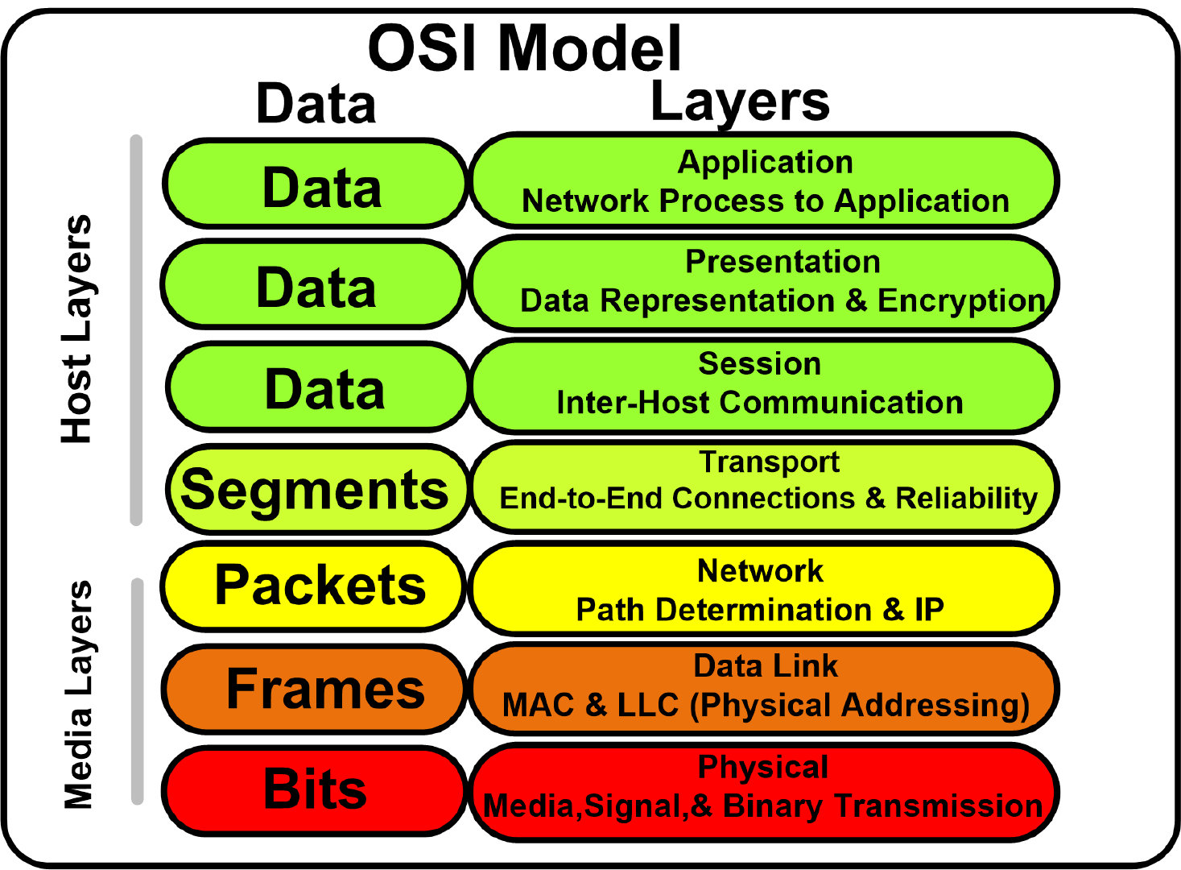
A general network model

Slide 7
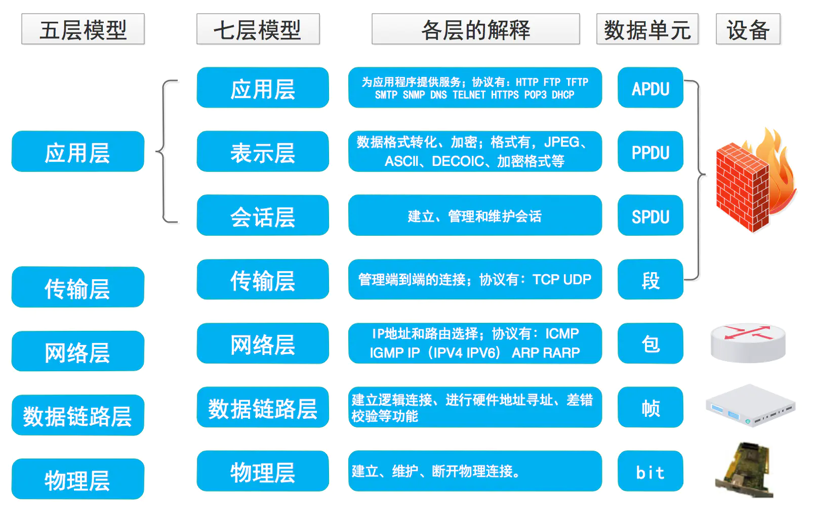

Slide 8
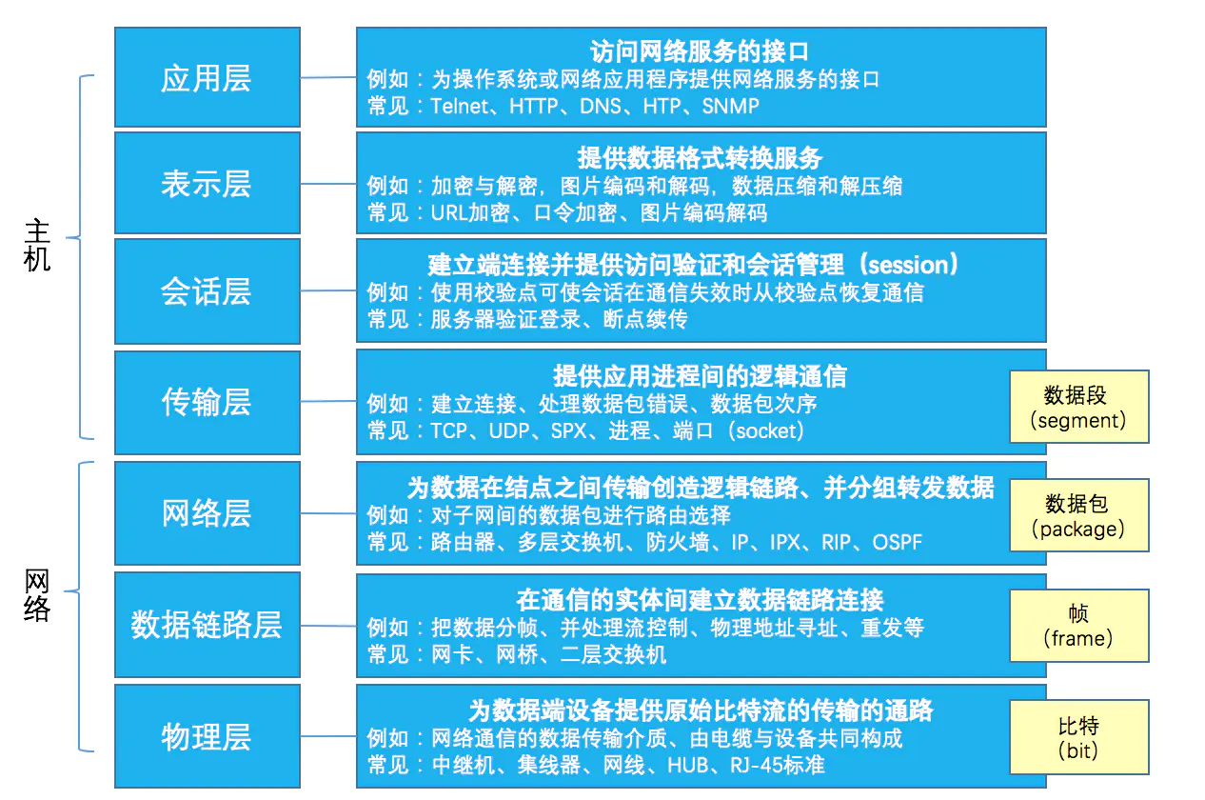

Slide 9
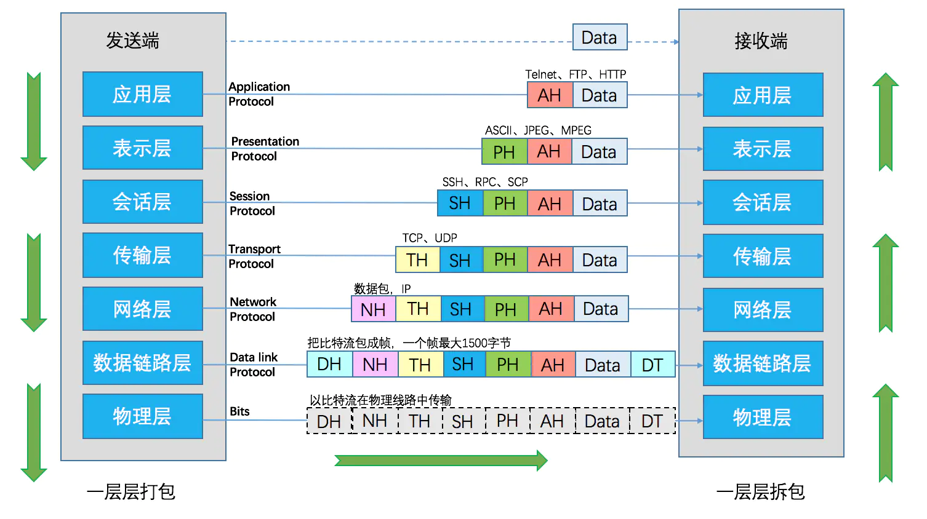

Slide 10

Internet
TCP
IP

Slide 11
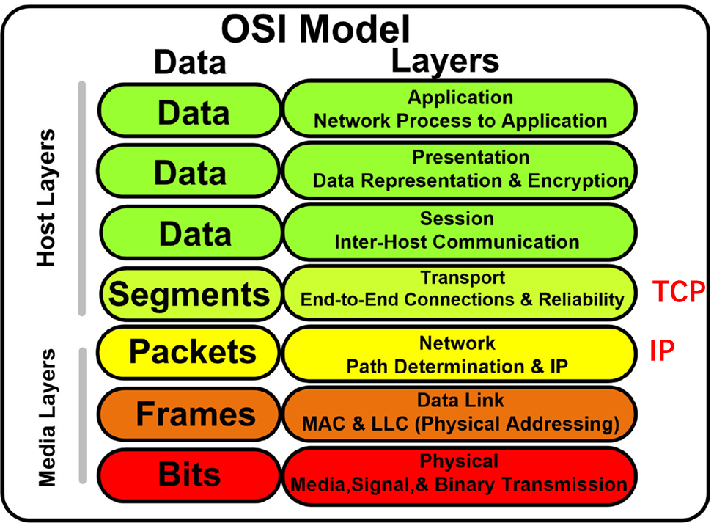
Web (WWW)
HTTP+html

Slide 12
Typical internet services (TCP/IP based App)
Web browser, http-url mediated apps
Email
ftp
remote host login
Weibo, Wechat, Zhifubao
Is 短信 an internet app?

Slide 13
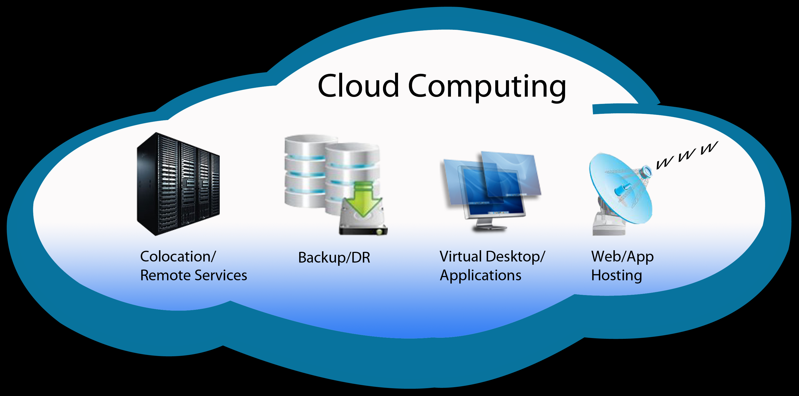
What is cloud computing?
Cloud
Huge (not for individual alone)
Remote (not interacting face to face)
Loose (not so tight coupled)
Cloud computing
wrap up networking computers into such a ‘cloud’
provide unified services just as local computers do, but with much lower price! 5-7 times saving in hardwares/power/management, increasing in utilities. In summary, 30+ times saving in total cost!
Pay for lower price with a little bit slower speed

Slide 14
Cloud networking
network management, control and even data connectivity onto cloud services.
Examples include using cloud-based network controllers to direct traffic across WAN connections or a cloud service provider's internal WAN to carry customer WAN traffic.

Slide 15

Internet is the carrier which delivers CC
Despite how complicate cloud constructs its intra-own networking, usually CC delivers services by internet.
internet
此照片，作者: 未知作者，许可证: CC BY-NC

Slide 16
How can CC provide service with lower price?
Share networked computers
Centralized maintenance, marginal utility
Time-sharing of networked resources
Users are not using their computing resources simultaneously

Slide 17
Cloud computing services
IaaS
Sell hardware
PaaS
+Sell platform
SaaS
+Sell service

Slide 18
Cloud computing features
Large scale
Virtualize
High reliability
Generalize
Scalability
On-demand service
Inexpensive

Slide 19
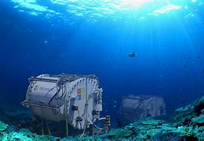
Successful commercial clouds
AWS
Azure
Google cloud
Aliyun

Slide 20
Cloud computing vs big data
Cloud computing is the processing platform for big data

Slide 21
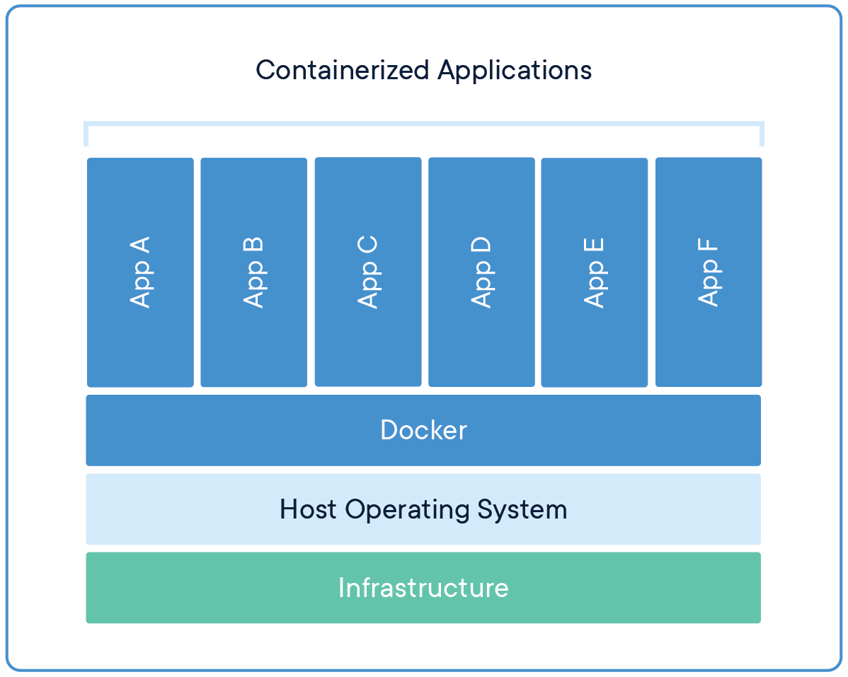
Delivery and execution of software under clouding computing: Docker

Slide 22
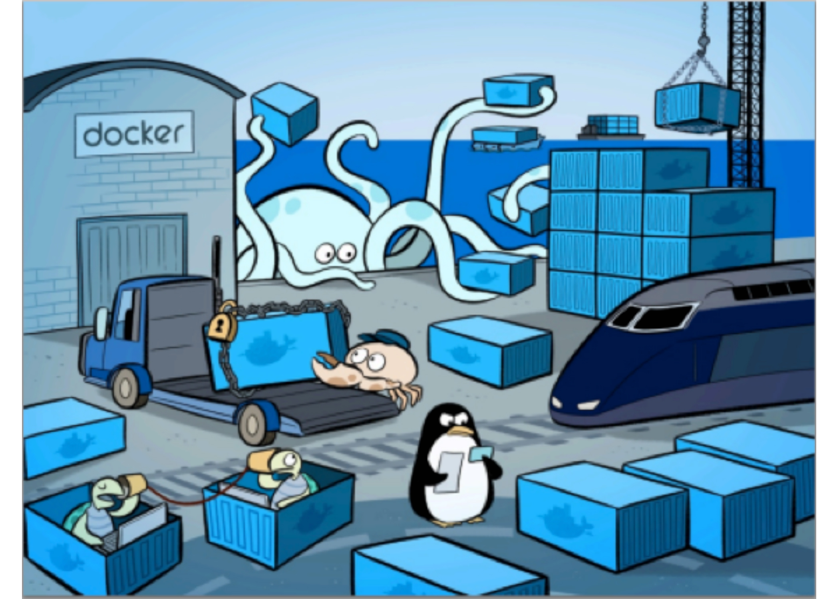
Standardization outside wraping variety inside

Slide 23
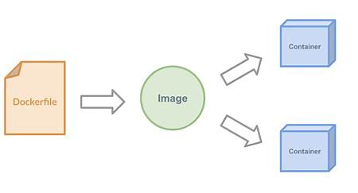
Making docker components

Slide 24
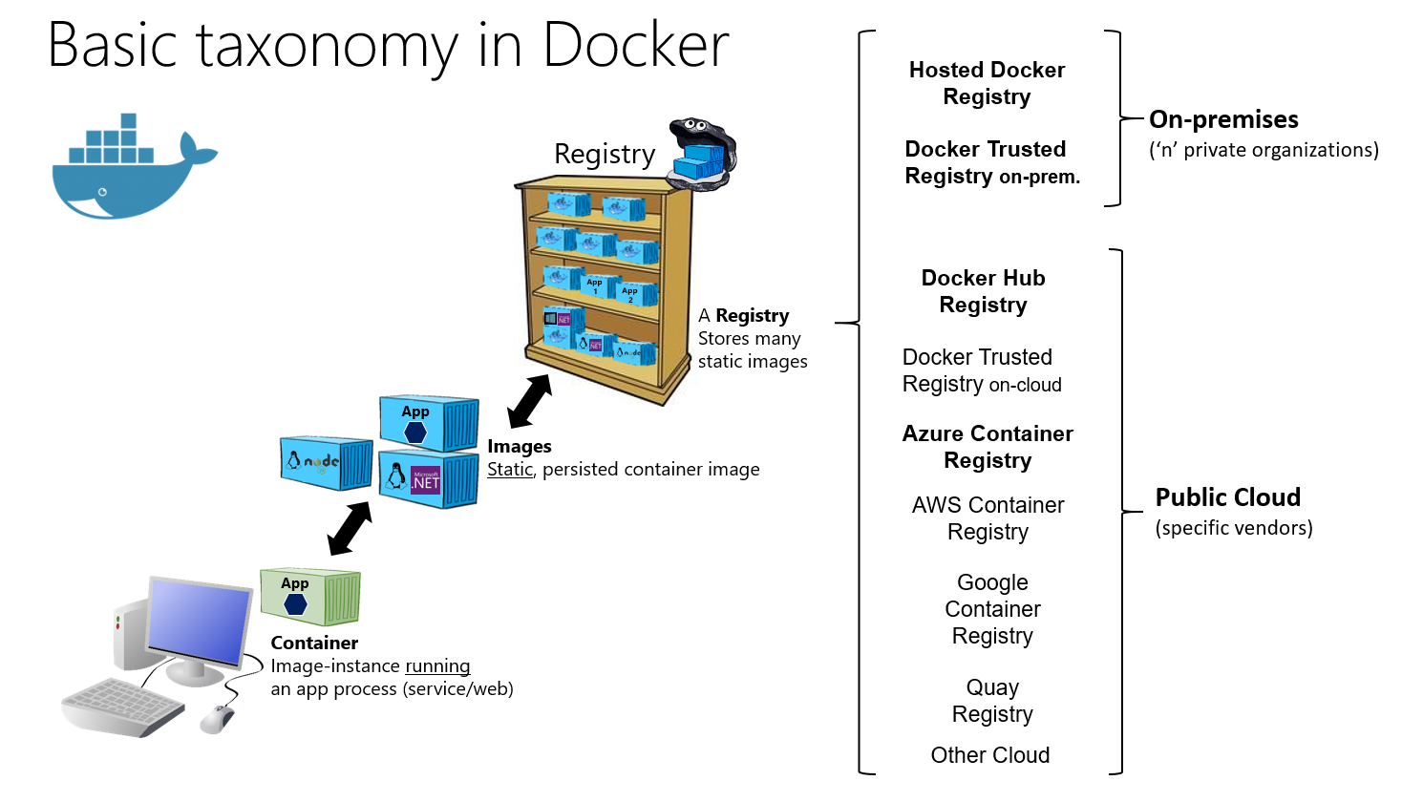

Slide 25
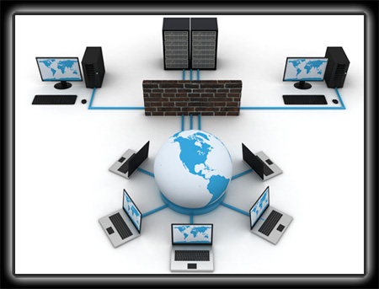
Cloud computing: a huge virtual “computer”
Key idea of this lecture

Slide 26
Homework 5
Design a product based on cloud computing. You have to justify why cloud computing is the necessary platform for your product.

